Slide 1
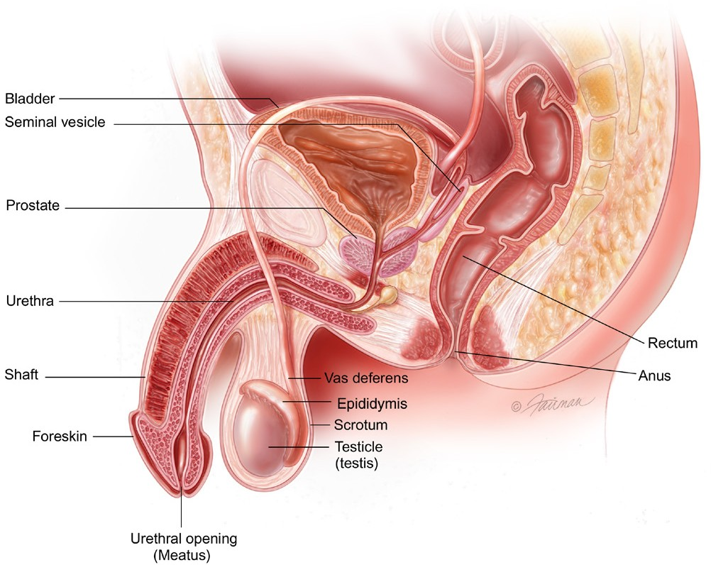
GET THE FACTS
What is the Prostate?
Benign growths, such as benign prostatic hyperplasia (BPH), are not life threatening. They do not spread to nearby tissue or other parts of the body. These growths can be removed and may grow back slowly (but often do not grow back).
Cancerous growths, such as prostate cancer, can spread (metastasize) to nearby organs and tissues such as the bladder or rectum, or to other parts of the body. If the abnormal growth is removed, it can still grow back. Prostate cancer can be life threatening if it spreads far beyond the prostate (metastatic disease).
The prostate* and seminal vesicles are part of the male reproductive system. The prostate is about the size of a walnut. The seminal vesicles are two smaller pairs of glands attached to the back of the prostate. The prostate sits below the bladder, in front of the rectum. It surrounds the urethra, a small tube that carries urine from the bladder out through the penis.
The main job of the prostate and seminal vesicles is to make fluid for semen. During ejaculation, sperm moves to the urethra. At the same time, fluid from the prostate and the seminal vesicles also moves into the urethra. This mixture— semen—goes through the urethra and out of the penis as ejaculate.
What is Early-stage Prostate Cancer?
Prostate cancer stays “localized” when cancer cells are found only in the prostate or even a little bit beyond it (extra-prostatic extension), but do not move to other parts of the body. If the cancer moves to other parts of the body, it is called “advanced” prostate cancer.
Prostate cancer is often grouped into four stages.
Male Reproductive System
Early-stage | Stages I & II: The tumor has not spread beyond the prostate. This is often called “early-stage” or “localized” prostate cancer.
Locally Advanced | Stage III: Cancer has spread outside the prostate, but only to nearby tissues. This is often called “locally advanced prostate cancer.”
Advanced | Stage IV: Cancer has spread outside the prostate to other parts such as the lymph nodes, bones, liver or lungs. This stage is often called “advanced prostate cancer.”
What is Prostate Cancer?
What Causes Prostate Cancer?
Cancer is the result of abnormal cell growth, which takes over the body’s normal cell function, making it harder for the body to work the way it should. Prostate cancer develops when abnormal cells form and grow in the prostate gland. Not all abnormal growths, also called
tumors, are cancerous (malignant). Some tumors are not cancerous (benign).
The cause of prostate cancer is unknown, but researchers know many things can increase a man's risk for the disease.
Age: As men age, their risk of getting prostate cancer goes up. Harm to the DNA (or genetic material) of prostate cells is more likely for men over the age of 55.
Ethnicity: African American men have a higher rate
of the disease. One in six African American men will be diagnosed with prostate cancer. Prostate cancer occurs less often in Asian American and Hispanic/Latino men than in non-Hispanic white men.
* All words that appear in blue Italics are explained in the glossary.
4

Slide 2
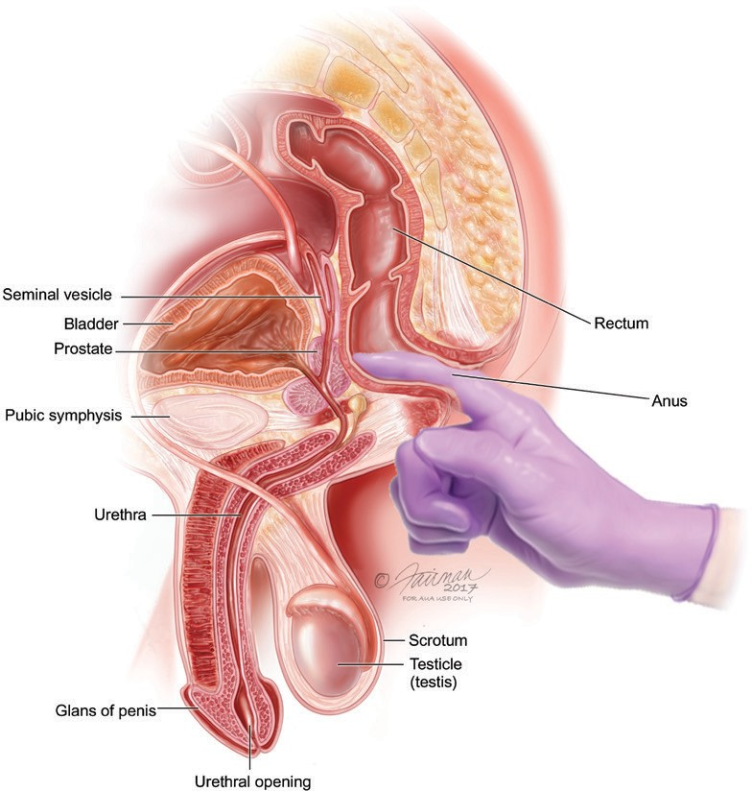
Family History: Men who have a grandfather, father or brother with prostate cancer face a higher risk of getting the disease. Having family members with breast and ovarian cancer also raises a man’s risk for prostate cancer.
Weight: Studies link being overweight in your 50s and later to a greater risk of advanced prostate cancer. Doctors advise keeping to a healthy weight to reduce risk.
Talk with your doctor if you have any of these symptoms:
Dull pain in the lower pelvic zone
Frequent need to pass urine
Trouble passing urine, pain, burning or weak urine flow
Blood in the urine (hematuria)
Painful ejaculation
Pain in the lower back, hips or upper thighs
Loss of hunger
Loss of weight
Bone pain
What are the Signs of Prostate Cancer?
In its early stages, prostate cancer may have no symptoms. When symptoms do occur, they can be urinary symptoms like those of an enlarged prostate or Benign Prostatic Hyperplasia (BPH).
GET DIAGNOSED
The American Urological Association (AUA) recommends talking with your doctor about the benefits and harms of screening (testing) for prostate cancer. If you fall into any of the groups below, you should think about talking to your doctor to see if screening is right for you:
The PSA test is not used alone to make a diagnosis. Your doctor may also use a digital rectal exam (DRE) test for a better sense of your prostate health.
Between 55–69 years old
African American
Have a family history of prostate cancer
Have symptoms
Digital Rectal Exam
The digital rectal exam (DRE) is a physical exam used to help your doctor feel for changes in your prostate.
Blood Tests
The PSA blood test measures a protein in your blood called the prostate-specific antigen (PSA). Only the prostate and prostate cancers make PSA. Results for this test are usually shared as nanograms of PSA per milliliter (ng/mL) of blood. The PSA test is used to look for changes to the way your prostate produces PSA. It is used to stage cancer, plan
treatment and track how well treatment is going. A rapid rise in PSA may be a sign something is wrong. In addition, your doctor may want to test the level of testosterone in
your blood.
5

Slide 3
This test is also used to screen for and stage cancer, or track how well treatment is going. During this test, the doctor feels for an abnormal shape, consistency, nodularity or thickness to the gland. For this exam, the doctor puts a lubricated gloved finger into the rectum.
The DRE is safe and easy, but cannot spot early cancer by itself. It is often done with a PSA test. Together, the PSA and DRE can help to find prostate cancer early, before it spreads. Early prostate cancer treatment may stop or slow the spread
of cancer.
The Gleason Score will help your doctor understand if the cancer is a low-, intermediate- or high-risk disease. The risk assessment is the risk of recurrence after treatment.
Generally, Gleason scores of 6 are treated as low-risk cancers. Gleason scores of around 7 are treated as intermediate/mid- level cancers. Gleason scores of 8 and above are treated as high-risk cancers. Some of these high-risk tumors may have already spread by the time they are found.
Staging
The Tumor, Nodes and Metastasis (TNM) is the system used for tumor staging. The TNM score is a measure of how far the prostate cancer has spread in the body. The T (tumor) score rates the size and extent of the original tumor. The N (nodes) score rates whether the cancer has spread into nearby lymph nodes. The M (metastasis) score rates whether the cancer has spread to distant sites.
Tumors found only in the prostate are more successfully treated than those that have metastasized (spread) outside the prostate. Tumors that have metastasized are incurable and require drug-based therapies to treat the whole body.
Biopsy
If screening tests show an issue with the prostate, a prostate biopsy may be performed. This helps make an accurate diagnosis. A biopsy is a tissue sample taken from your prostate or other organs to look for cancer cells. There are many approaches to prostate biopsies. These can be done through a probe placed in the rectum, through the skin of the perineum (between the scrotum and rectum) and may use a specialized imaging device, such as an MRI Scan. The biopsy removes small pieces of tissue for review under a microscope. The biopsy takes 10 to 20 minutes. A
pathologist (a doctor who classifies disease) looks for cancer cells within the samples. If cancer is seen, the pathologist will "grade" the tumor.
Staging and Grading
Prostate cancer is grouped into four stages. The stages are defined by how much and how quickly the cancer cells are growing. The stages are defined by the Gleason Score and the T (tumor), N (node), M (metastasis) Score.
Gleason Score
If a biopsy finds cancer, the pathologist gives it a grade. The most common grading system is called the Gleason grading system. The Gleason score is a measure of how quickly the cancer cells can grow and affect other tissue. Biopsy samples are taken from the prostate and given a Gleason grade by a pathologist. Lower grades are given to samples with small, closely packed cells. Higher grades are given to samples with more spread out cells. The Gleason score is set by adding together the two most common grades found in a biopsy sample.
6

Slide 4
GET TREATED
Early-stage prostate cancer is a cancer that has grown in the prostate, but not escaped beyond it to other parts of the body, like lymph nodes or bones. Men with early-stage prostate cancer have a very good chance of survival. There are several options for treatment.
Your treatment plan will consider:
a biopsy and possibly an MRI. Men on active surveillance are generally able to avoid urinary, sexual and bowel side effects. You may want to think of active surveillance as a treatment that helps you keep the quality of your life for
as long as possible.
Some men never need to have any other treatment. If the PSA rises and a biopsy shows that the cancer is growing, it is time to talk about taking more action to get rid of the cancer, such as with surgery or radiation therapy. That kind of treatment is called ‘definitive therapy’.
The stage and grade of the cancer (Gleason score and TNM stage)
Your risk category (whether the cancer is low-, intermediate- or high-risk
Your age and health
Your preferences about side effects and long-term effects of treatment
Your treatment goals
Results from other diagnostic tests
Watchful Waiting
Watchful waiting is a way to track the cancer without treating it. It does not involve routine PSA tests, biopsies or other active surveillance tools. The risk of watchful waiting is that the cancer could grow and spread between
follow-up visits. Watchful waiting is sometimes the approach taken with men with early-stage prostate cancer who are older and likely to die of other causes. It is also for men
who have other health issues that would make it difficult for them to undergo surgery or radiation.
The two main treatments for early-stage prostate cancer are surgery and radiation therapy. The goal of these treatments is to get rid of the cancer for good. They have about the same success in treating the cancer. You can talk with your doctor about which treatment is best for you.
When you get your prostate cancer diagnosis, think over your range of treatment choices. Learn the odds of survival that different treatments offer and learn about the side effects of each treatment. Keep in mind how side effects of treatment will change your life now and in the future. If you can, get a second or third opinion from different prostate cancer experts. Talking with a urologist and a radiation oncologist can help you make informed choices.
Learn about the skill and reputation of doctors available to treat you. An experienced doctor with a good reputation will likely do the best job for you, especially if the treatment
you choose might have side effects like urinary incontinence, erectile dysfunction (ED) or bowel problems. Find out
what program your doctor offers to help with the side effects after treatment. Ask other survivors about their experiences.
If you decide on a treatment, use the time before treatment to get or stay healthy. With the guidance of your doctor, eat a well-balanced diet, strive for a healthy weight, exercise
and avoid smoking and too much alcohol. This may help you combat prostate cancer.
Here are the treatments that you may want to discuss with your doctor if you are diagnosed with early-stage, localized prostate cancer.
Surgery
A radical prostatectomy is the surgical removal of the prostate, seminal vesicles and nearby tissue. Often the lymph nodes in the pelvis that drain from the prostate are also removed. This procedure calls for anesthesia and a short hospital stay.
There are four types of radical prostatectomy surgery:
Robotic Assisted Laparoscopic Radical Prostatectomy (RALP). In this surgery, five very small incisions (cuts) are made in the lower abdomen through which instruments and a small camera are guided to allow the surgeon access to remove the prostate. RALP surgery is one of the most common types of prostate cancer surgery today.
Active Surveillance
Active Surveillance is best if you have a small and slow- growing cancer. Your doctor will check your prostate cancer by asking you to have tests every few months. Tests that usually help are a blood test to check your PSA,
7

Slide 5
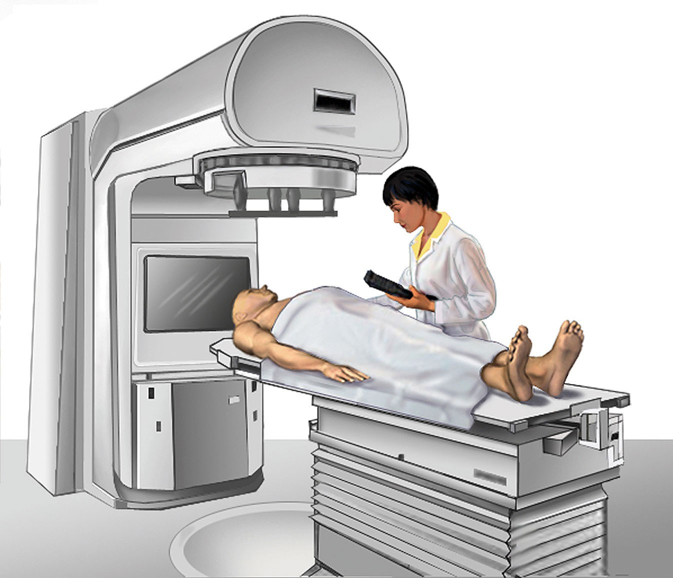
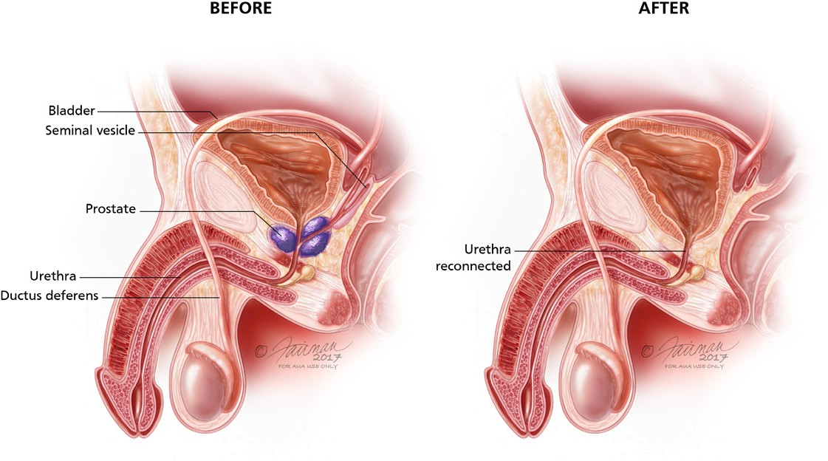
Retropubic Open Radical Prostatectomy. Your surgeon will make a cut in your lower belly and remove the prostate through this opening.
Perineal Open Radical Prostatectomy. The prostate is removed through a cut between the anus and scrotum. Because the complex pelvic veins are avoided, bleeding is rare.
Laparoscopic Radical Prostatectomy. This surgery uses a video camera and small surgical tools that fit through cuts in the belly to remove the prostate. This surgery has mostly been replaced with robotic assisted laparoscopic surgery.
A small amount of radiation is delivered in daily doses to the prostate for a number of weeks. Your health care team will limit radiation going to healthy organs like the bladder and rectum. Newer EBRT technology makes three-dimensional images with conformal radiotherapy (3DCRT), Proton Beam Therapy (PBT) or Stereotactic Body Radiation Therapy (SBRT).
After surgery, your surgeon will review your final pathology report with you. The pathology report will tell you your final Gleason Score based on all the cancer that was in your prostate.
As with all surgery, there is risk for bleeding, infection and pain in the short term. The main side effects from this surgery are erectile dysfunction (ED) and urinary incontinence (loss of urine control). Most men recover the control of their bladder within several months.
For some men, erections can recover, but sometimes not all the way. Your surgeon can help you manage these side effects or give you a referral to other specialists who
can help.
External Beam Radiation Therapy (EBRT) machine
Prostate Brachytherapy (Internal Radiation Therapy)
is radiation treatment targeting the prostate from inside the body. Radioactive material is placed in the prostate using needles or a tube. There are two types of brachytherapy:
low dose rate (LDR) brachytherapy, and
high dose rate (HDR) brachytherapy.
Anesthesia and a short stay in the hospital are needed for both.
Common side effects after radiation are urinary incontinence, bowel problems and ED. Urinary and bowel problems get better for most men. Erections gradually soften over a period of two or more years. Your doctor will discuss these side effects with you and help you manage them. Ask your doctor about the effect of different radiation approaches on your erectile function. Some treatments are less likely to cause ED.
Sometimes radiation therapy is combined with hormone therapy to shrink the prostate before starting treatment. Or hormone therapy may be combined with external beam therapy to make the radiation more effective. Hormone therapy is called Androgen Deprivation Therapy (ADT).
Radiation Therapy
Radiation therapy uses high-energy rays to kill the cancer cells.
External beam radiation therapy (EBRT) sends a targeted photon beam (x-ray) of radiation from outside the body to the prostate.
8

Slide 6
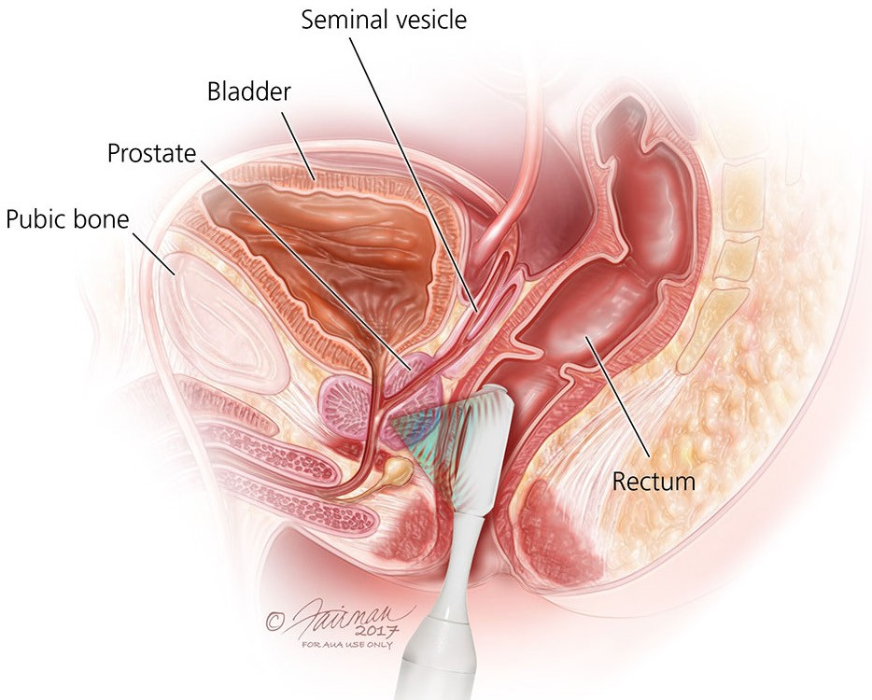
ADT fights prostate cancer by removing testosterone from the body. The loss of testosterone helps fight cancer but may include major side effects such as loss of libido, ED, hot flashes, changes in body fat and emotions. There could be other body changes as well. It is best to talk to your doctor about this.
The types of high-intensity focused ultrasound (HIFU)
and focal therapy are:
High-intensity focused ultrasound (HIFU) uses the energy of sound waves to target and superheat the tumor to kill cells (with the help of MRI scans). It may
be used for the whole gland.
Focal cryoablation uses a needle-thin probe to circle the tumor with a special mixture that kills the tumor by freezing it.
Irreversible electroporation uses a “NanoKnife” to pass an electrical current through the tumor. The electricity makes very tiny holes (called pores) in the tumor’s cells, leading to cell death
Whole Gland or Focal Prostate Ablation
Cryotherapy or cryoablation for prostate cancer is the controlled freezing of the prostate gland. The freezing kills cancer cells. Special needles called "cryoprobes", guided by ultrasound, are placed in the prostate to direct the
freezing process. Cryotherapy is done under general or spinal anesthesia. After cryotherapy, a patient is checked with routine PSA tests and biopsy. Possible side effects include
ED, incontinence and other urinary or bowel problems. Your doctor will discuss with you how to manage them.
Focal therapy is a treatment under study for men with small, early-stage prostate tumors. Small tumors inside the prostate are targeted and destroyed without having to remove or radiate the whole prostate. This targeted approach leads to less intense side effects.
9

Slide 7
OTHER CONSIDERATIONS
Once you have finished treatment, you may have to manage side effects. You will also make a long-term plan with your doctor for future tests. These tests check to make sure you stay cancer-free.
Incontinence
After prostate cancer surgery or radiation, you may experience a loss of urine control. Incontinence is the inability to control the release of urine and can sometimes happen with prostate cancer treatment. There are different types of incontinence:
Erectile Dysfunction
Men may have sexual health problems following their cancer diagnosis or treatments. Erectile dysfunction (ED) is when a man finds it hard to get or keep an erection strong enough for sex. ED happens when there is not enough blood flow to the penis, or when nerves to the penis are harmed.
Cancer in the prostate, colon, rectum and bladder are the most common cancers that can affect a man’s sexual health. Treatments for cancer, along with emotional stress, can lead to ED.
The chance of ED after prostate cancer treatment depends on many things, such as:
Stress Incontinence (SUI), when urine leaks with coughing, laughing, sneezing or exercising or with any additional pressure on the pelvic floor muscles. This is the most common type.
Urge Incontinence, or the sudden urge to pass urine, even when the bladder is not full because the bladder is overly sensitive. This might be called overactive bladder (OAB).
Mixed Incontinence, a combination of stress and urge incontinence with symptoms from both types.
Age
Overall health
Medications you take
Sexual function before treatment
Cancer stage
Damage to your nerves or blood vessels from surgery or radiation
Short–term incontinence after surgery is common. If you have SUI, you may only need to wear a pad for a few weeks to months. Incontinence often does not last long and urinary control will return. For a few men, it can last as long as six to twelve months. Because incontinence may affect your physical and emotional recovery, it is of great
value to understand how to manage this problem. There are treatment choices to help incontinence.
There are treatments that may help ED. They include pills, vacuum pumps, urethral suppositories, penile injections and implants. Treatment can be individualized. Some treatments may work better for you than others. They have their own set of side effects. A doctor can talk with you about the pros and cons of each method. They can help you decide which single treatment or combination of treatments is right for you.
There may be a change in orgasm for men treated with surgery as they no longer ejaculate or ejaculate a small volume of urine because the prostate, which makes semen, has been removed. However, it is still possible to have an orgasm.
Kegel exercises may strengthen your bladder control muscles.
Lifestyle changes may improve your urinary functions. Try eating healthier foods, limiting smoking, losing weight and making timed visits to the bathroom.
Medication may help improve bladder control by affecting the nerves and muscles around the bladder.
Neuromuscular electrical stimulation uses a device to help strengthen bladder muscles.
Surgery to control urination may include injecting collagen to tighten the bladder sphincter, implanting a urethral sling to tighten the bladder neck, or an artificial sphincter device.
Products, such as pads, may help you stay dry but do not treat incontinence.
Avoid bladder irritants that include caffeine, alcohol and artificial sweeteners.
10

Slide 8
Long–term incontinence lasting more than a year is rare. It happens in less than 5–10 percent of all surgical cases. If it does happen, talk to your doctor about your choices for care.
Pelvic floor exercise may help men being treated for prostate cancer. The pelvic floor is a group of muscles and structures in your pelvis between your legs. The pelvic floor supports the bowel, bladder and sexual organs. They help with urinary and fecal functions as well as sexual performance.
The muscles contract and relax, just like any other muscle in your body. Pelvic floor exercises can help with side effects like erectile dysfunction and urinary incontinence.
Lifestyle Changes
Diet
A healthy diet may increase your energy levels and enhance your immune system. It is of great value to think about the foods you eat and to try to maintain a healthy weight.
Healthy eating habits can improve your health and risks.
Healthy food choices may include:
Emotional Stress
Plenty of fruits and vegetables
High fiber foods
Low fat foods
Limited amounts of simple sugars
Limited amounts of processed foods (especially processed meats like deli foods and bacon)
After treatment, some men feel relieved the cancer is gone. Many men may worry about cancer coming back (recurrence). If the cancer returns, you and your doctor will talk about next steps and make a plan.
Some men are upset by the side effects of treatment. Urinary and erection problems can feel like a loss of one’s usual self. Those feelings are normal and will get better as you learn to manage your side effects and see improvements. Whatever you are feeling, it is worth telling your doctor. Cancer is always stressful and a trained counselor may help you manage your mental health.
If you have a partner, be sure that your partner is a part of what you are going through. Couples cope better when they approach cancer treatment and the side effects of treatment as a team. If you do not have a partner, talk to a friend you trust about what you are going through.
If you find you and your partner are not coping well, feel down or very anxious, it may help to talk to a counselor or a sex therapist to get support.
Because prostate cancer treatment can affect your appetite, eating habits and weight, it is of great value to try your best to eat healthy. If you have a hard time eating well, reach out to a registered dietitian/nutritionist (RDN). There are ways to help you get the nutrition you need.
Exercise
Physical exercise may improve your physical and emotional health. It can also help you manage your weight, maintain muscle and bone strength and help manage side effects.
If approved by your doctor, you may want to exercise one to three hours per week. Cardiovascular exercise and strength/ resistance training may be good choices. This can include walking or more intense exercise. Physical exercise may help you to:
Reduce anxiety
Improve energy
Improve self-esteem
Feel more hopeful
Improve heart health
Reach a healthy weight
Boost muscle strength
Maintain bone health
11

